Slide 1
PROBABILITY AND STATISTICS
Notes:
galvanizeopensource.github.io/stats-shortcourse

Slide 2
Day 1 - Tuesday
Probability
Probability Distributions
Day 2 - Thursday
Bayesian Inference
Statistics Concepts
Statistical Inference
Regression, Classification, Evaluation
Data Science Immersive

Slide 3

Probability
Probability = $\frac{\text{\# }\text{outcomes} \text{we} \text{like}}{\text{\# }\text{total} \text{possible}\text{ (}\text{equally} \text{likely}\text{) }\text{outcomes} }$

Slide 4
Boring
Just a matter of counting
(Permutations and Combinations)
Notes:
http://www.dcrossantiques.com/locks/ADDmillerPERMUTAIONlock.jpg
https://i2.wp.com/roomescapeartist.com/wp-content/uploads/2017/12/Philosoraptor-Combination-Locks.jpg?ssl=1

Slide 5
INDEPENDENCE AND MUTUAL EXCLUSIVITY

Slide 6
INDEPENDENCE AND MUTUAL EXCLUSIVITY
INDEPENDENCE
In probability theory, two events are independent if the occurrence of one does not affect the probability of occurrence of the other.
MUTUAL EXCLUSIVITY
In probability theory, two events are mutually exclusive if they cannot both occur (be true).
(text adapted from Wikipedia)

Slide 7

INDEPENDENCE
If A and B are independent, $P\left(A and B\right)=\text{P}\text{(}\text{A}\text{∪}\text{B}\text{) = }\text{P}\text{(}\text{A}\text{) * }\text{P}\text{(}\text{B}\text{)}$
The probability of my friend in DC missing her train to work is 10% and the probability of my friend in NY missing her train to work is 30%.
What is the probability that both friends will miss the train tomorrow?
Notes:
Independent, then P(A and B) = P(A)*P(B)
Exclusive, then P(A or B) = P(A) + P(B)

Slide 8
Visualization
INDEPENDENCE

Slide 9
INDEPENDENCE AND MUTUAL EXCLUSIVITY
INDEPENDENCE
In probability theory, two events are independent if the occurrence of one does not affect the probability of occurrence of the other.
MUTUAL EXCLUSIVITY
In probability theory, two events are mutually exclusive if they cannot both occur (be true).
(text adapted from Wikipedia)

Slide 10

MUTUAL EXCLUSIVITY
If A and B are mutually exclusive, $P\left(A or B\right)=\text{P}\text{(}\text{A}\text{) + }\text{P}\text{(}\text{B}\text{)}$
The probability of getting sushi for dinner is 20% and the probability of getting Thai for dinner is 30%.
What is the probability of getting sushi or Thai?
Notes:
Independent, then P(A and B) = P(A)*P(B)
Exclusive, then P(A or B) = P(A) + P(B)

Slide 11
Visualization
MUTUAL EXCLUSIVITY

Slide 12
Independence vs Mutual Exclusivity
Independent and Mutually Exclusive | Independent but not Mutually Exclusive
Not Independent but Mutually Exclusive | Neither Independent nor Mutually Exclusive
Notes:
Independent, then P(A and B) = P(A)*P(B)
Exclusive, then P(A or B) = P(A) + P(B)

Slide 13
THE SYSTEM BREAKS DOWN

Slide 14
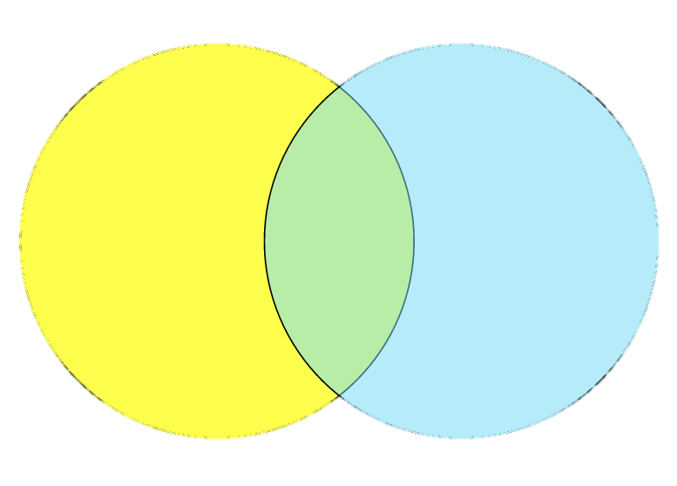

What if they aren't MUTUALLY EXCLUSIVE?
I roll a single die. What is the probability of it being odd or greater than three?
$$P\left(A or B\right) =P\left(A\right)+P\left(B\right)$$
$$P\left(odd or>3\right) =P\left(odd\right)+P\left(>3\right)$$
$=\frac{1}{2}+\frac{1}{2}=1$
odd
> 3
(WRONG)
Notes:
expect 5/6
P(odd) + P(>3) – P(odd and >3)

Slide 15

What if they aren't MUTUALLY EXCLUSIVE?
I roll a single die. What is the probability of it being odd or greater than three?
$$P\left(A or B\right) =P\left(A\right)+P\left(B\right)−P(A and B)$$
$P\left(odd or>3\right) =P\left(odd\right)+P\left(>3\right)−P(odd and>3)$
$=\frac{1}{2}+\frac{1}{2}−\frac{1}{6}=\frac{5}{6}$
odd
> 3
(RIGHT)
Notes:
expect 5/6
P(odd) + P(>3) – P(odd and >3)

Slide 16
EXAMPLE
I draw a card from a regular deck of playing cards. What is the probability that the card is a diamond or a face card?

Slide 17

What if they aren't INDEPENDENT?
I roll a single die. What is the probability of it being odd and greater than three?
$$P\left(A and B\right) =P\left(A\right)∗P\left(B\right)$$
$$P\left(odd and>3\right) =P\left(odd\right)∗P\left(>3\right)$$
$=\frac{1}{2}∗\frac{1}{2}=\frac{1}{4}$
odd
> 3
(WRONG)
Notes:
expect 5/6
P(odd) + P(>3) – P(odd and >3)

Slide 18

What if they aren't INDEPENDENT?
I roll a single die. What is the probability of it being odd and greater than three?
$$P\left(A and B\right) =P\left(A\right)∗P\left(B|A\right)$$
$$P\left(odd and>3\right) =P\left(odd\right)∗P\left(>3|odd\right)$$
$=\frac{1}{2}∗\frac{1}{3}=\frac{1}{6}$
odd
> 3
(RIGHT)

Slide 19
EXAMPLE
 | Percent of School Pop | Percent Left-Handed
Freshman | 20% | 10%
Sophomore | 25% | 15%
Junior | 25% | 8%
Senior | 30% | 12%
odd
> 3
If I choose a student at random, what is the probability that the student is a left-handed junior?
Notes:
3/6 * 1/3 = 3/9
Pr(A|B)=Pr(A∩B)Pr(B)

Slide 20
BAYES RULE
Notes:
https://pictures.abebooks.com/isbn/9780956372840-us.jpg
http://www.mathisintheair.org/wp/wp-content/uploads/2016/02/bayes.gif

Slide 21
Bayes Rule
 | Percent of School Pop | Percent Left-Handed
Freshman | 20% | 10%
Sophomore | 25% | 15%
Junior | 25% | 8%
Senior | 30% | 12%
Before: If I choose a student at random, what is the probability that the student is a left-handed junior?
Now: If I choose a student at random and he is left handed, what is the probability that the student is a junior?

Slide 22
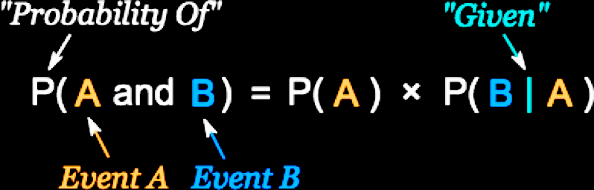

Bayes Rule
The Algebra:
$P(A and B) = P(B and A)$
$P(A)∗P(B|A) = P(B)∗P(A|B)$
$divide both sides by P(A): P(B|A) = \frac{P\left(B\right) ∗ P(A|B)}{P(A) }$
Notes:
P(A and B) = P(A) * P(B|A)
P(A and B) = P(B and A)
P(A)*P(B|A) = P(B)*P(A|B)
divide both sides by P(B|A):
P(A) = P(B)*P(A|B) / P(B|A)

Slide 23

Bayes Rule
odd
> 3
The Visual:
The probability of being odd
given that
a die roll is greater than three
A:
B:
$$P(B|A) = \frac{P\left(B\right) ∗ P(A|B)}{P(A) }$$
Notes:
expect: 1/3
A: greater than three
B: being odd
P(being odd) * P(greater than three given odd) / P(greater than three) = ½ * 1/3 / 1/3

Slide 24
Example:
 | Percent of School Pop | Percent Left-Handed
Freshman | 20% | 10%
Sophomore | 25% | 15%
Junior | 25% | 8%
Senior | 30% | 12%
If I choose a student at random and he is left handed, what is the probability that the student is a junior?

Slide 25
Example:
A routine test for HIV came back positive. What is the chance that you have HIV?
0.5 % of US adults have HIV
The test isn't 100% perfect.
If you have HIV it catches it 98% of the time.
If you don’t have HIV it gives a false positive 3% of the time.

Slide 26

MATH:
0.5 % of US adults have HIV
The test isn't 100% perfect.
If you have HIV it catches it 98% of the time.
If you don’t have HIV it gives a false positive 3% of the time.
$$P(HIV|+test) =\frac{P(+test|HIV) P(HIV)}{P(+test) }$$
$$P(+test|HIV+) = .98$$
$$P(HIV) = .005$$
$$P(+test) = P(HIV+ and +test) + P(HIV− and +test)$$
$= P\left(HIV−\right) P\left(+test | HIV−\right)+ P\left(HIV+\right) P(+test|HIV+)$
$=\left(.995\right)\left(.03\right) + \left(.005\right)\left(.98\right)$
$= 0.03475$
$$P(HIV+|+test) = (.98)(.005)/(0.03475) = 0.14100719424$$
Notes:
P(HIV|+test) = P(+test|HIV) P(HIV) / P(+test)
P(+test|HIV+) = .98
P(HIV) = .005
P(+test) = P(HIV+ and +test) + P(HIV- and +test)
= P(HIV-)P(+test|HIV-) + P(HIV+)P(+test|HIV+)
=(.995)(.03) + (.005)(.98) = 0.03475
P(HIV|+test) = (.98)(.005)/(0.03475) = 0.14100719424

Slide 27
Visualization:
0.5 % of US adults have HIV
The test isn't 100% perfect.
If you have HIV it catches it 98% of the time.
If you don’t have HIV it gives a false positive 3% of the time.
250,000,000 US adults, they all take the test
250,000,000 * .005 = 1,250,000 have HIV
1,250,000 * .98 = 1,225,000 get a true positive
1,250,000 * .02 = 25,000 get a false negative
250,000,000 * .995 = 248,750,000 don't have HIV
248,750,000 * .97 = 241,287,500 get a true negative
248,750,000 * .03 = 7,462,500 get a false positive
1,225,000 + 7,462,500 have a positive test
Notes:
all positive = TP + FP = 1,225,000 + 7,462,500 = 8,687,500
prob of false positive = 7,462,500 / 8,687,500 = .86

Slide 28
Practice #1 (answer online)
odd
> 3
 | Percent of School Pop | Percent Left-Handed
Freshman | 20% | 10%
Sophomore | 25% | 15%
Junior | 25% | 8%
Senior | 30% | 12%
If I choose a student at random, what is the probability that the student is a right handed senior?
Notes:
P(sr and rt handed) = P(sr)* P(rt|sr) = (.3)*(.12) = .036

Slide 29
Practice #2 (answer online)
odd
> 3
 | Percent of School Pop | Percent Left-Handed
Freshman | 20% | 10%
Sophomore | 25% | 15%
Junior | 25% | 8%
Senior | 30% | 12%
My new friend is left handed. What is the chance that my friend is a sophomore? (left handed students make up 11.35% of the school population)
Notes:
P(soph|lft) = P(soph)P(lft|soph) / P(lft) = (.25)*(.15) / (.2*.1)+(.25*.15)+(.25*.08)+(.3*.12) = (.25)*(.15) / .1135 = 33%

Slide 30
Practice #3 (answer online)
I have two coins, one normal (50% heads, 50% tails), one weighted to be 80% heads and 20% tails. I randomly choose a coin and flip it. It lands as heads. What is the chance that I chose the fair coin?
Notes:
P(fair|heads) = P(fair)P(heads|fair) / P(heads) = .5*.5 / (.5*.5)+(.5*.8) = .38

Slide 31
Notes:
https://qph.fs.quoracdn.net/main-qimg-ed318384ec2e55ed3f6b834dd6025ba4-c

Slide 32
Probability Distributions

Slide 33
Random Variables
what are they?
a quantity having a numerical value for each member of a group, especially one whose values occur according to a frequency distribution.
x-axis of the distribution

Slide 34
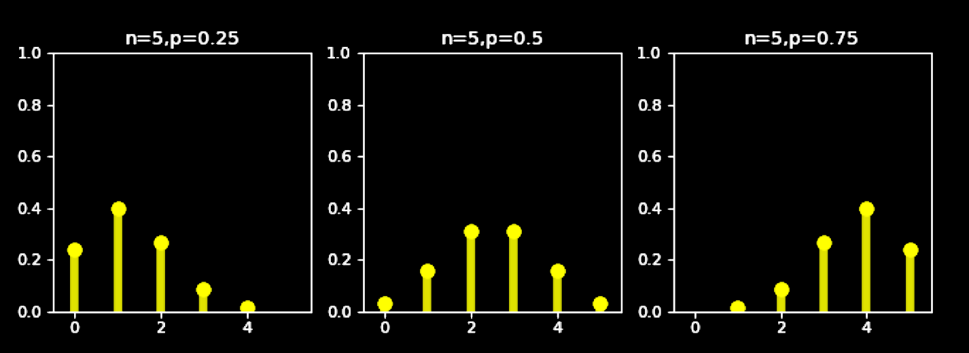
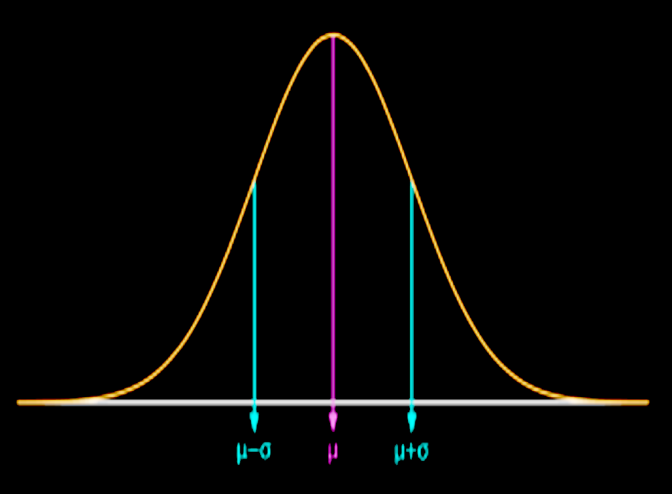
CONTINUOUS VERSUS DISCRETE VARIABLES

Slide 35
Probability Distribution Function

Slide 36
PROBABILITY MASS FUNCTION
Input – Random Variable
Output – Probability of Observing that Variable

Slide 37
DISCRETE VARIABLES

Slide 38
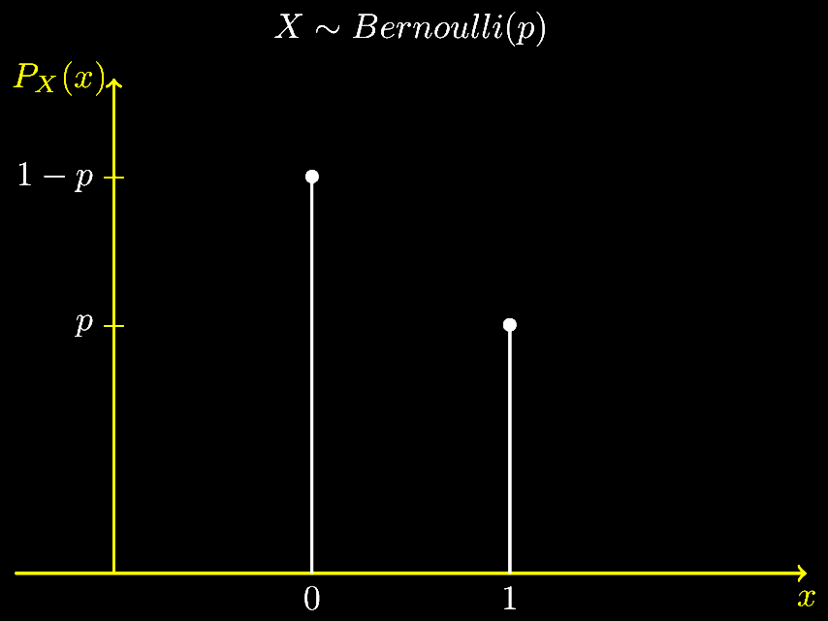
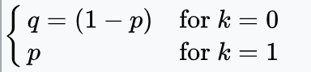
Bernoulli

Slide 39
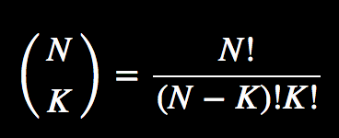
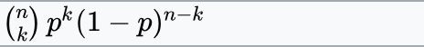
Binomial

Slide 40
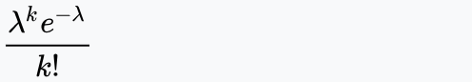
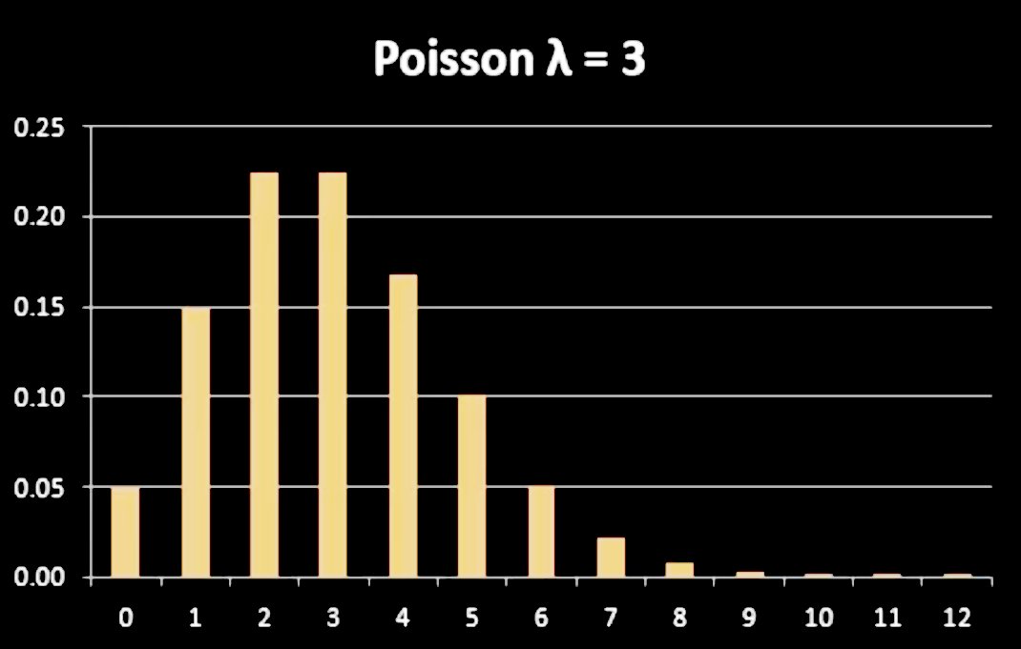
Poisson
Model the number of times an event occurs in a fixed time interval

Slide 41
Discrete Questions:
I flip a coin 20 times. What is the probability that it lands heads at least 3 times?

Slide 42
Discrete Questions:
I run a restaurant and on a typical Tuesday morning, 5 people show up every 10 minutes. What is the probability that 2 people show up in the next ten minutes?

Slide 43
CONTINUOUS VARIABLES

Slide 44
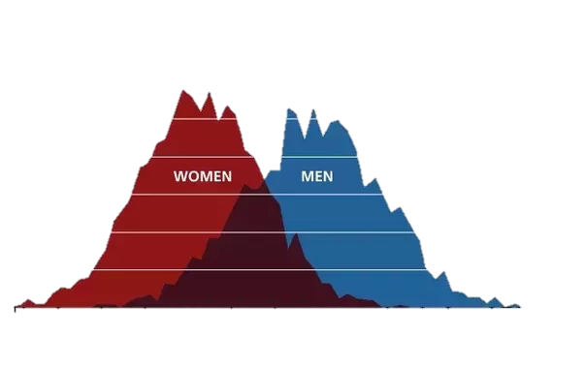
PROBABILITY DISTRIBUTION FUNCTION
Input – Range of a Random Variable
Output – Probability of Observing that Variable in that range

Slide 45
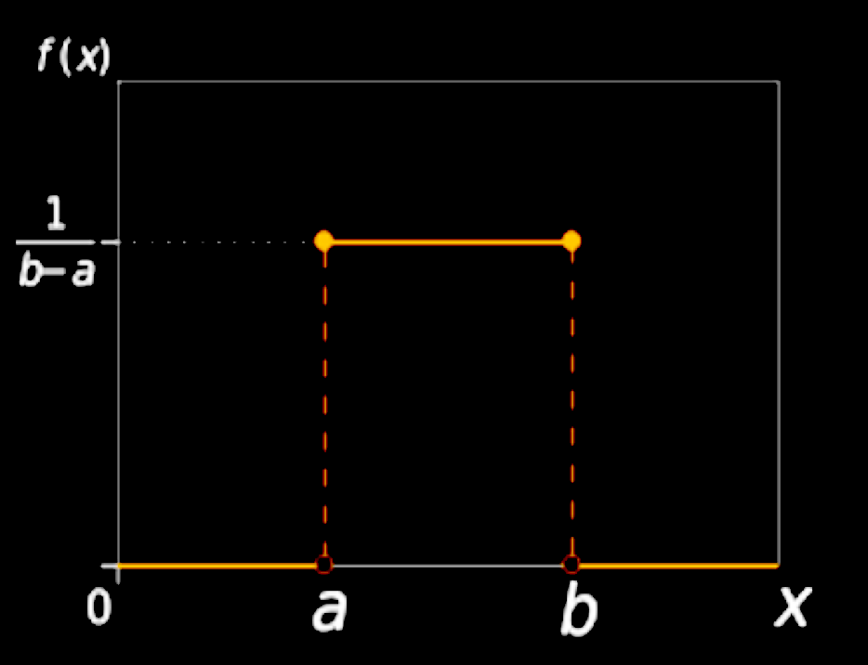
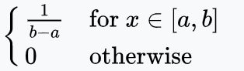
Uniform

Slide 46
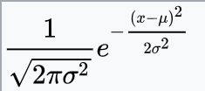
Normal / Gaussian

Slide 47
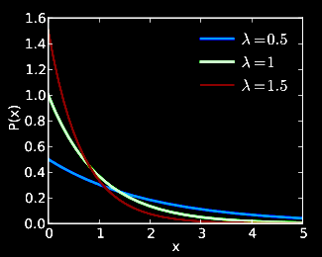
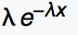
Exponential

